Slide 1
Was Disney really successful in discouraging stereotypes?

Slide 2
Stereotypical behaviors of Animals
→ undermines the main message of discouraging stereotypes

Slide 3
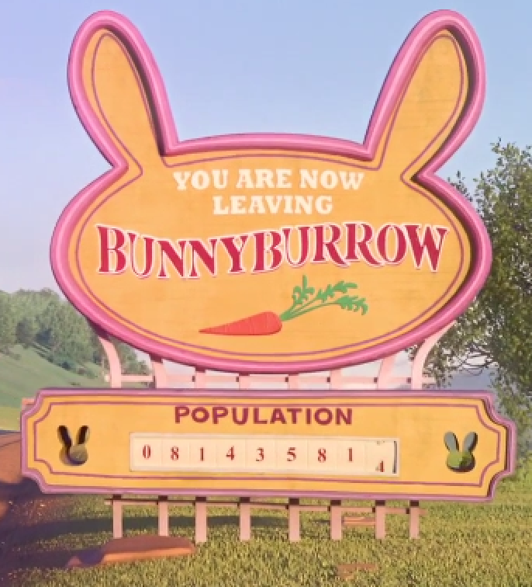
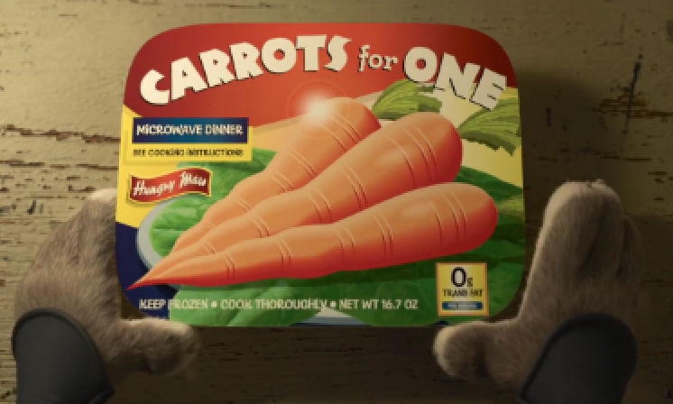
Example: Bunnies
Carrots
Prolificacy

Slide 4
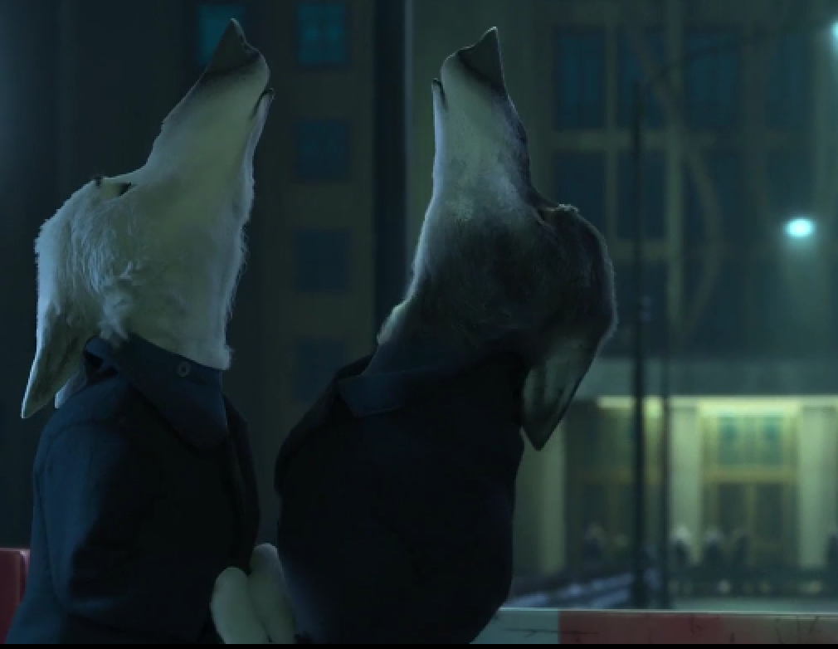
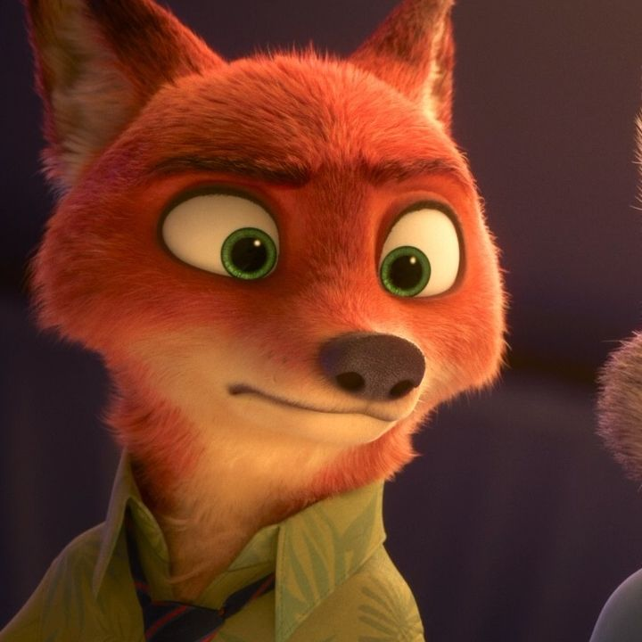
Example: Wolves
What is it with wolves and the howling?
Howling

Slide 5
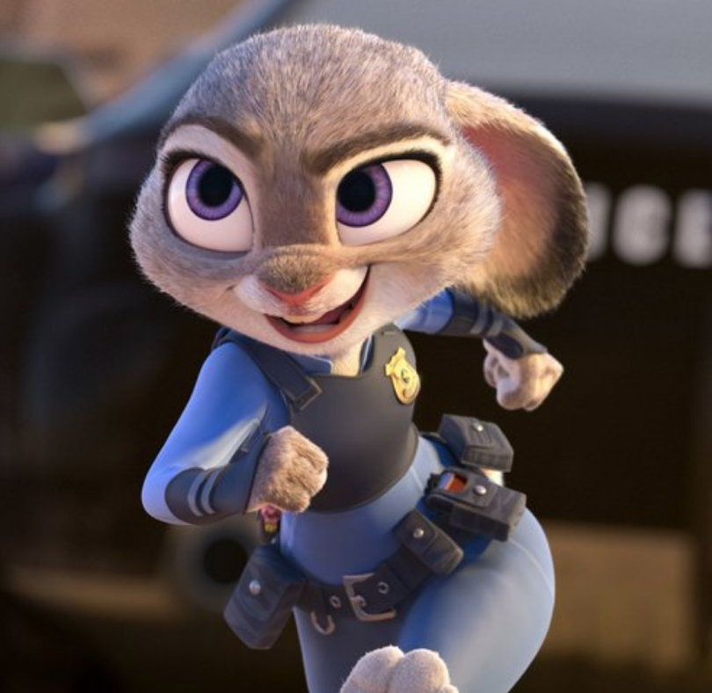
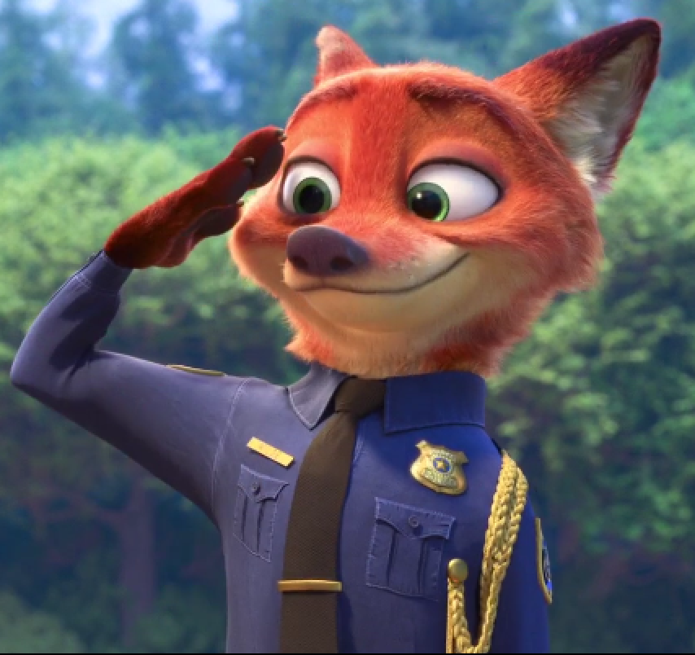
Different because these stereotypes are not countered
←→ Bunnies = weak; foxes = sly → refuted
Judy – competent
Nick – brave & trustworthy
reinforces the idea that particular groups behave in a characteristic way

Slide 6
Conspiracy of the prey

Slide 7
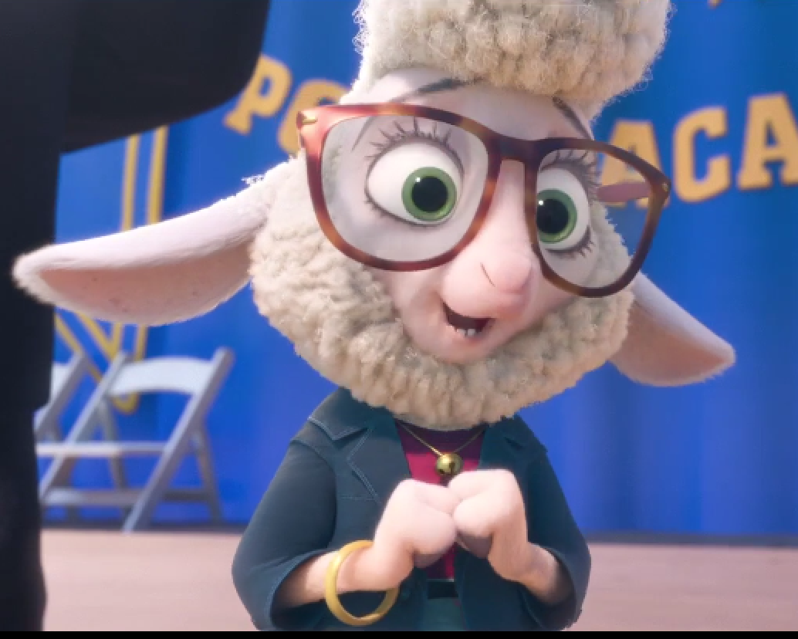
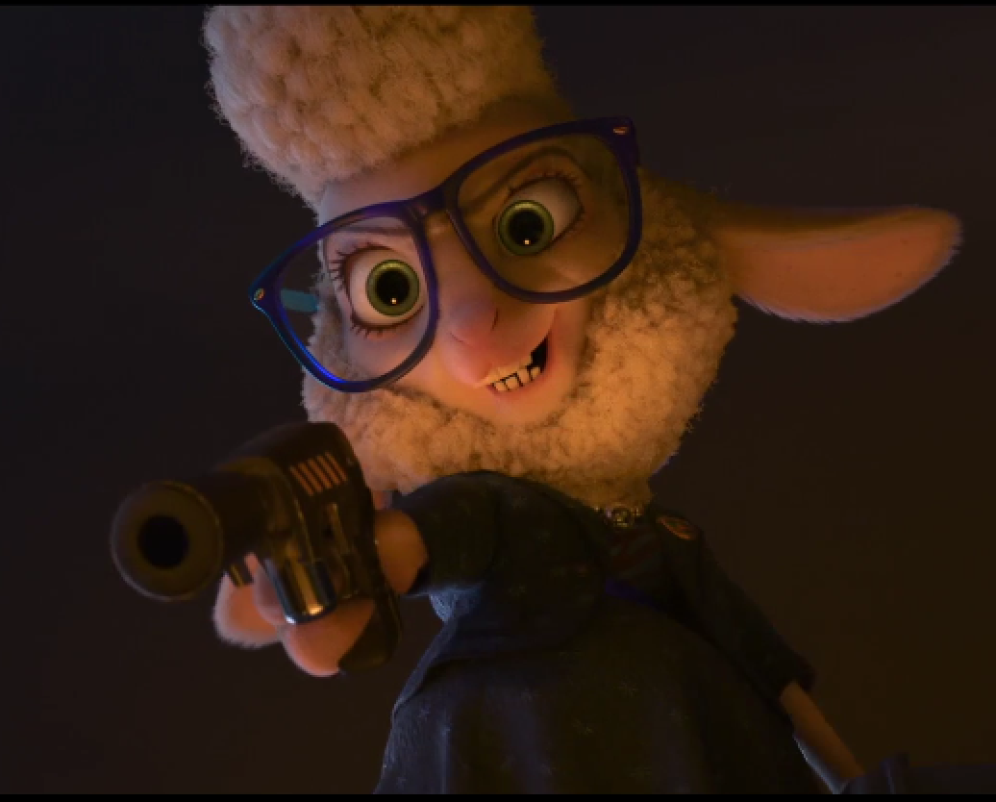
Actually
Seems nice and harmonious with predators
Powerhungry and bloodthirsty; tries to turn the society against the predators
→ socially suppressed groups are actually against the socially superb groups, and are willing to harm them in order to step up the social ladder

Slide 8
Black Panther

Slide 9
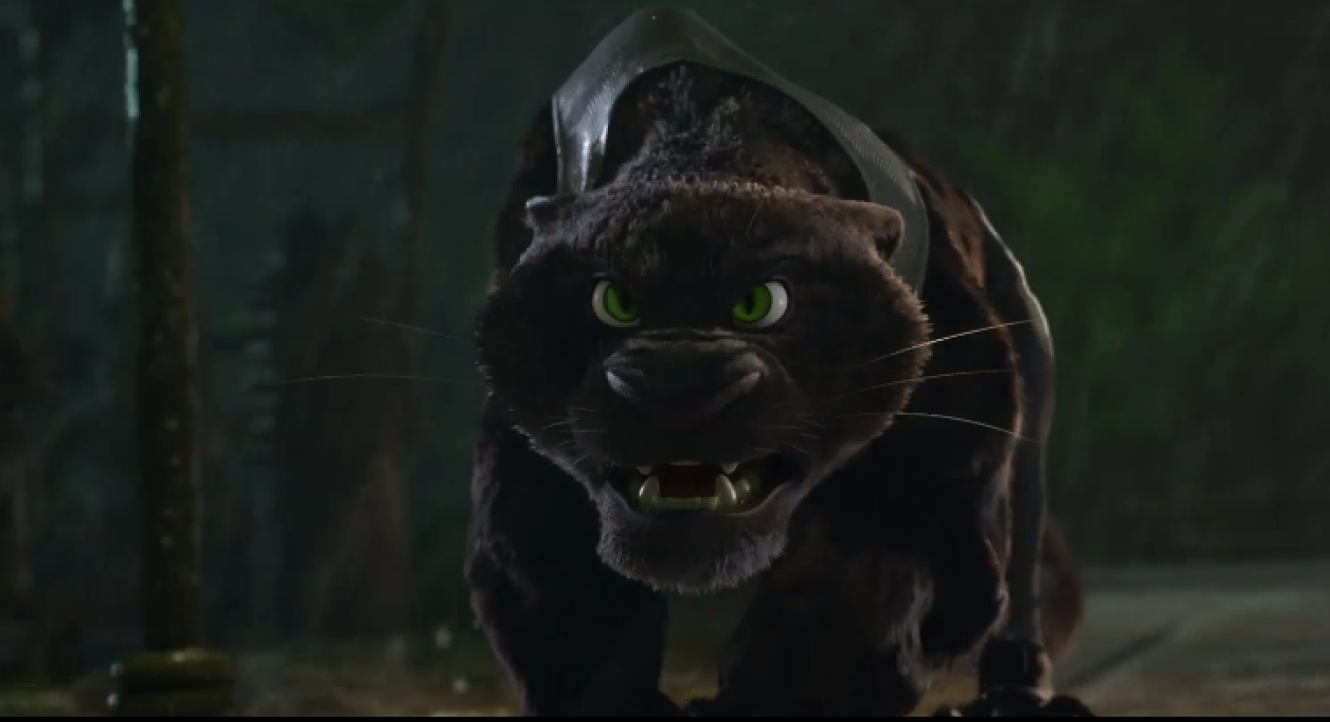
Puma that attacks Nick and Judy = black panther
→ latently associates black skin color with negative, dangerous characteristics

